Slide 1
Domain Adaptation
Li Niu

Slide 2
Domain Adaptation
Traditional era
Early deep era
GAN era

Slide 3
Domain Adaptation
Traditional era
Projection to common subspace
Interpolation on the manifold
Sample selection
Domain-invariant dictionary
Low-rank reconstruction

Slide 4
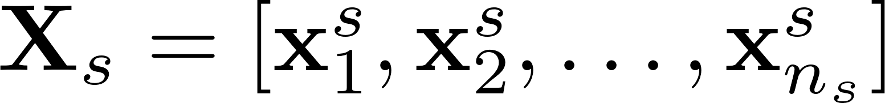
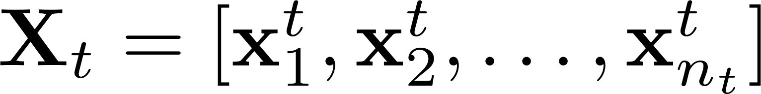
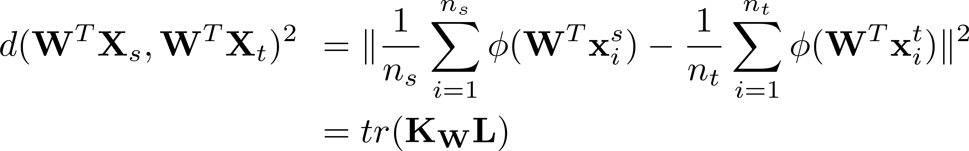
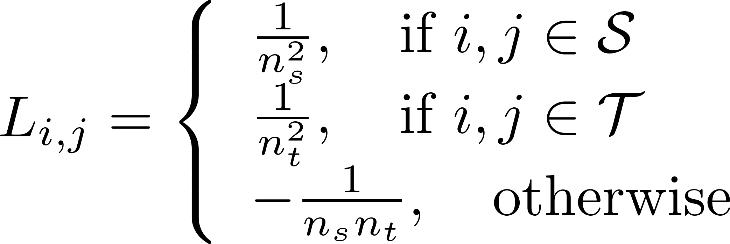
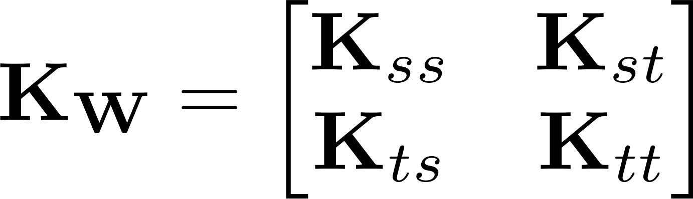
Domain Invariant Projection (DIP)
Baktashmotlagh, Mahsa, et al. "Unsupervised domain adaptation by domain invariant projection." ICCV, 2013.
source
target

Slide 5
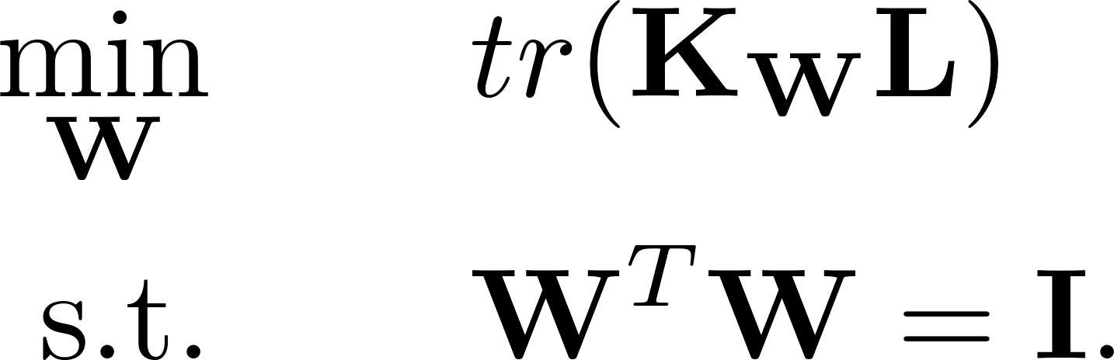
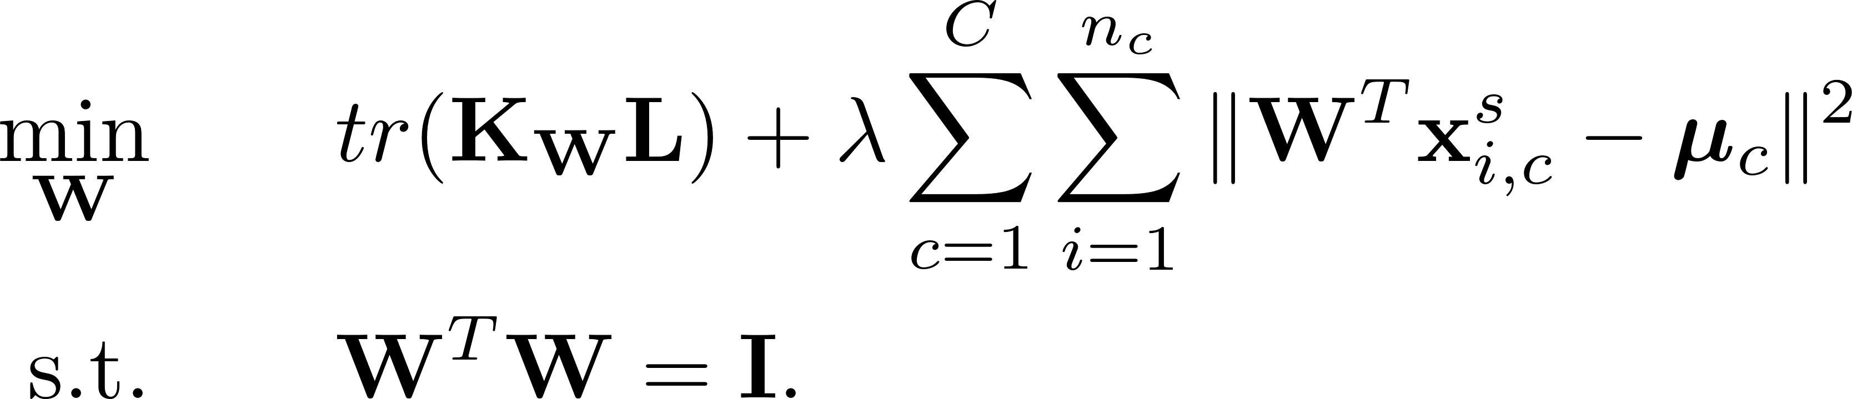

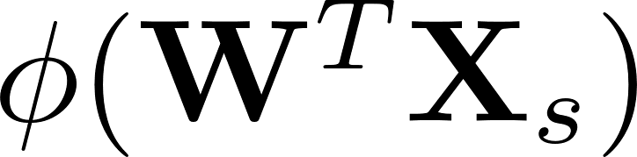
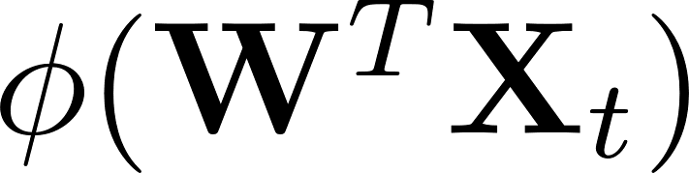
Domain Invariant Projection (DIP)
DIP
Class Clustering
DIP-CC
After obtaining , use and

Slide 6
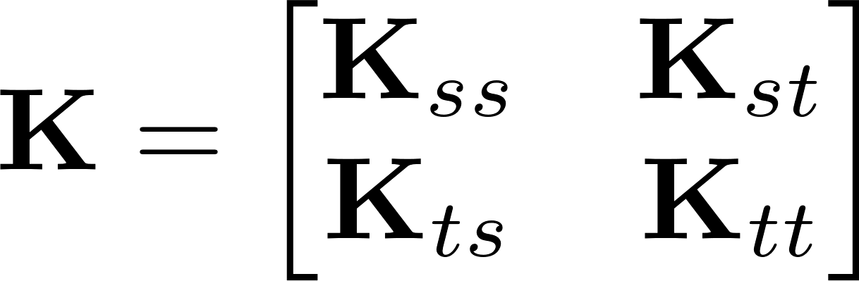
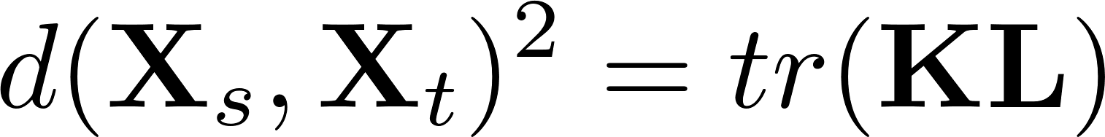

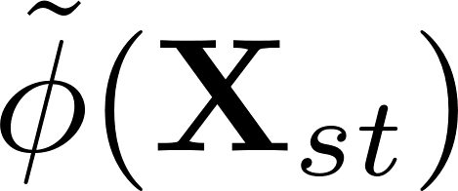

Transfer Component Analysis (TCA)
Pan, Sinno Jialin, et al. "Domain adaptation via transfer component analysis.“ TNN (2011): 199-210.
, in which
Introduce transformation matrix for fake representation
, in which

Slide 7
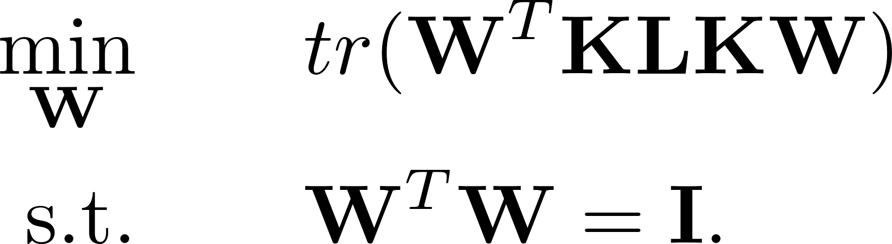
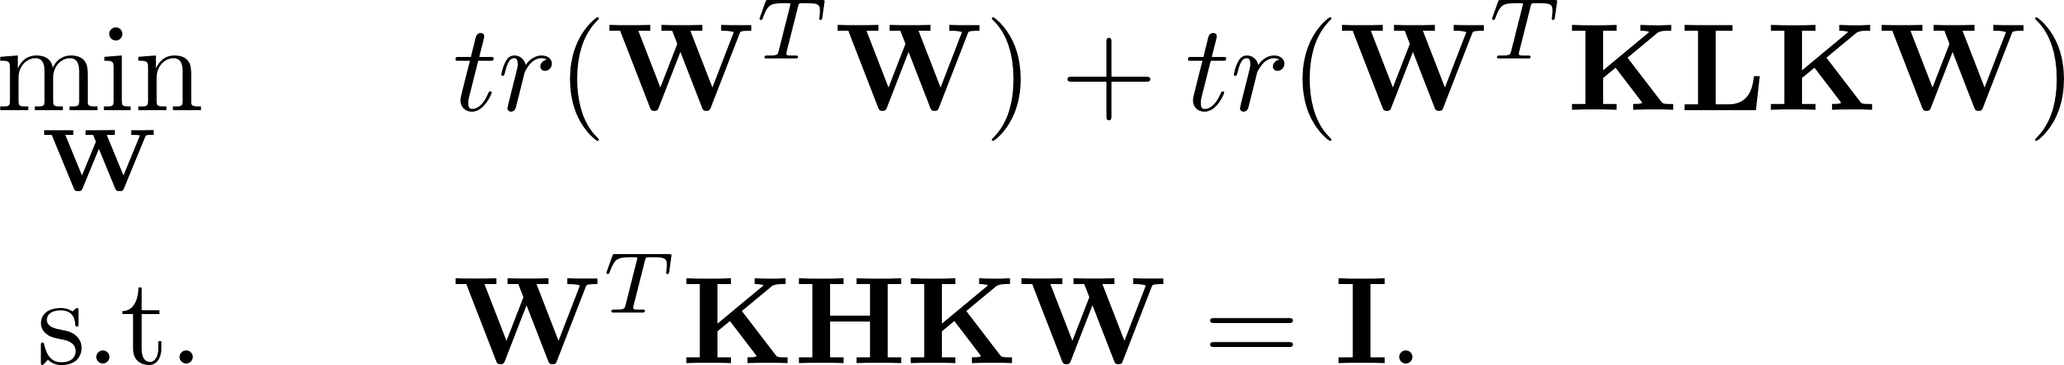
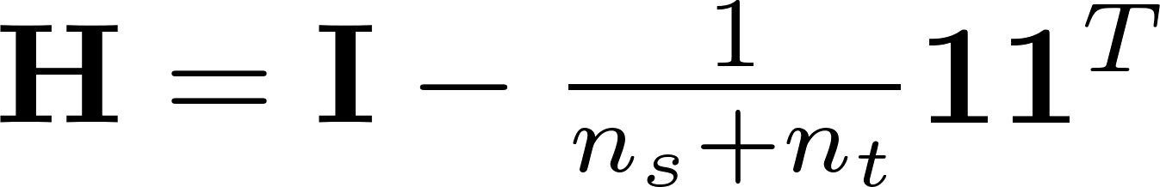

Transfer Component Analysis (TCA)
TCA
normalization constraint
After obtaining , use the new kernel

Slide 8
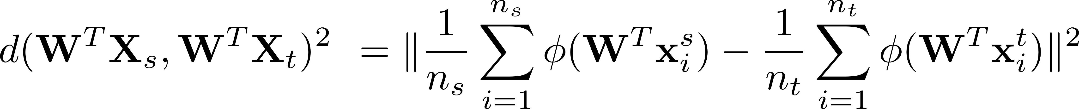
Relation Between DIP and TCA
DIP: apply projection before kernelization
TCA: apply projection after kernelization

Slide 9
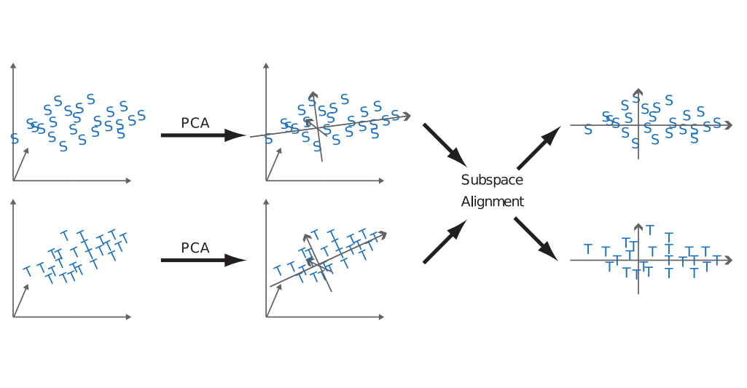
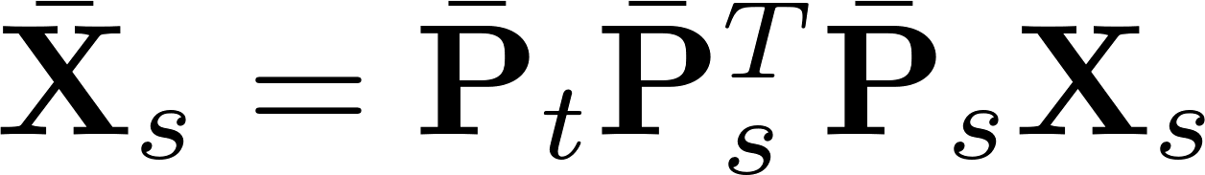
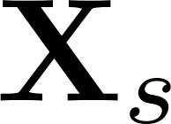
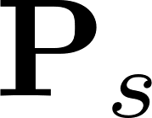
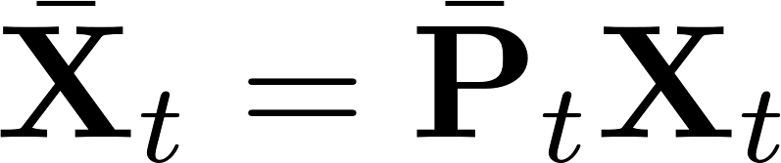
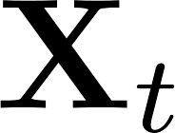
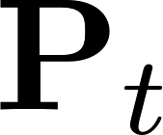
Subspace Alignment (SA)
Fernando, Basura, et al. "Unsupervised visual domain adaptation using subspace alignment." ICCV, 2013.

Slide 10
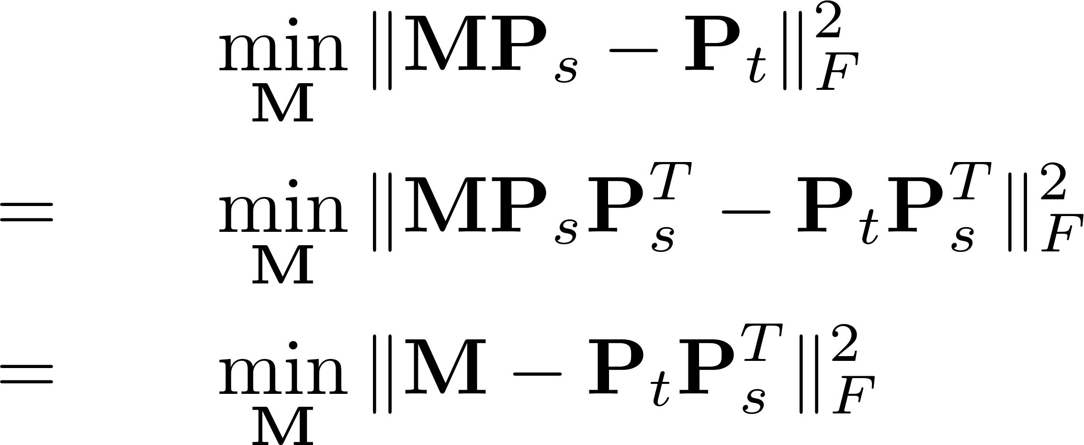
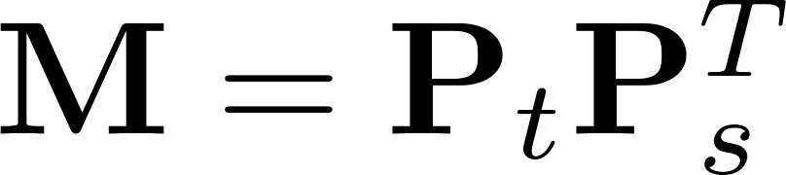
Subspace Alignment (SA)
PCA
PCA

Slide 11
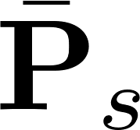
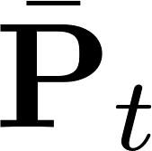
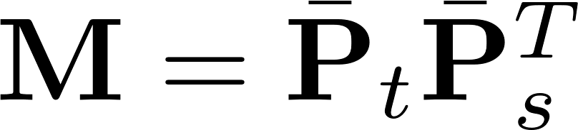
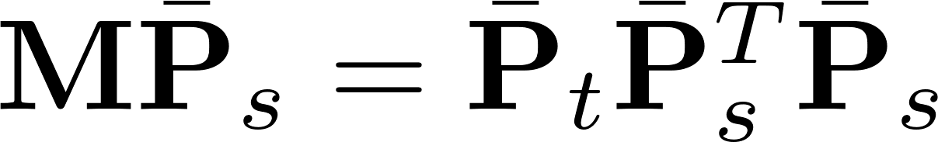
Subspace Alignment (SA)
Keep leading vectors in and , get and
Aligned source subspace:

Slide 12
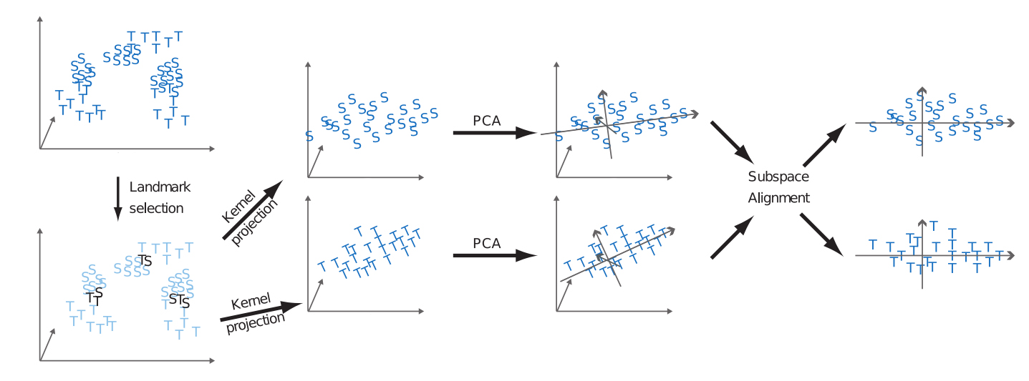
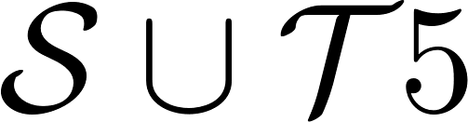

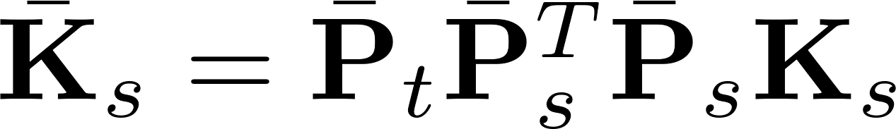
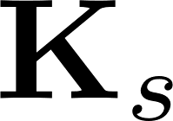
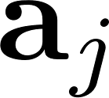
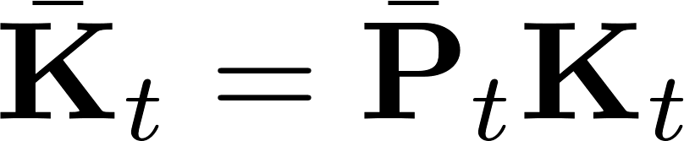
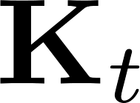

Landmarks Selection-based Subspace Alignment (LSSA)
Aljundi, Rahaf, et al. "Landmarks-based kernelized subspace alignment for unsupervised domain adaptation." CVPR, 2015.
landmarks selection and kernel projection

Slide 13
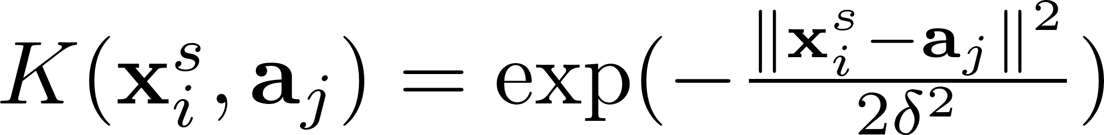
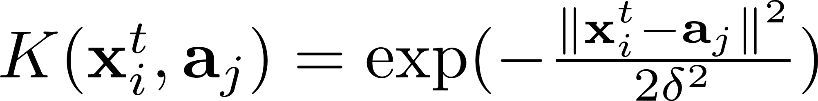
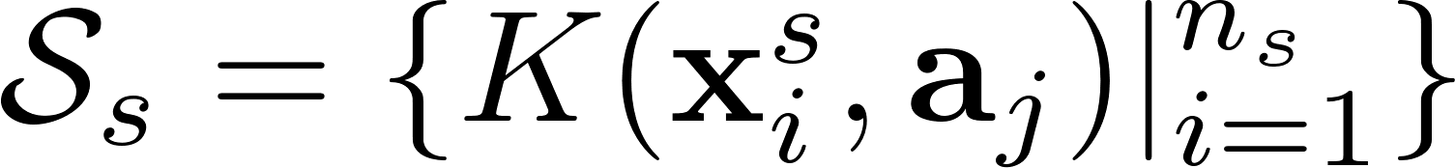
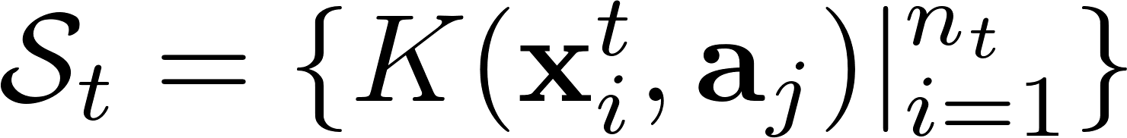
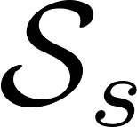
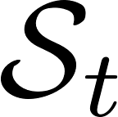
Landmarks Selection-based Subspace Alignment (LSSA)
Landmarks selection
For each , we have and
Select those
for which the distributions and have the largest overlap.
Kernel projection

Slide 14


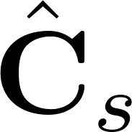
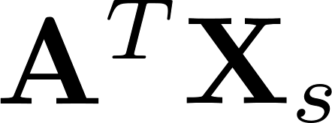
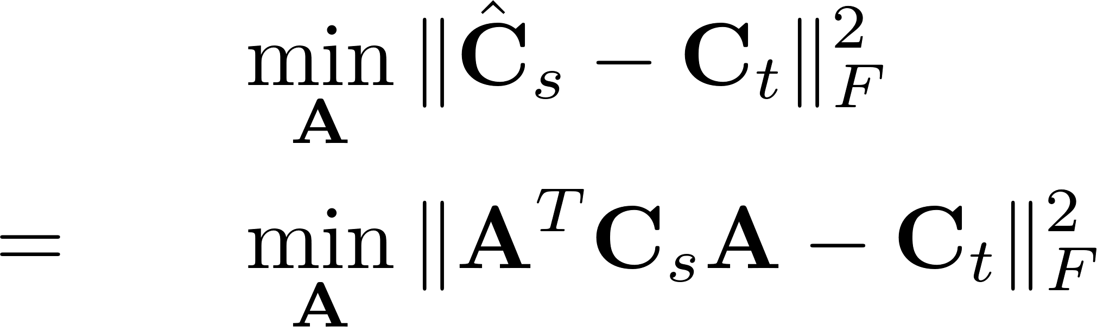
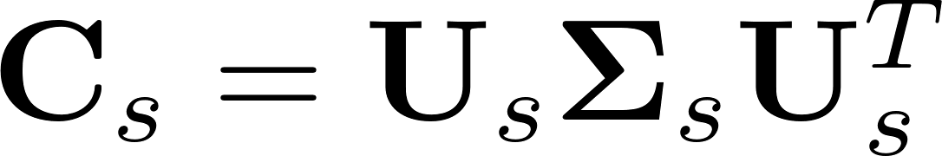
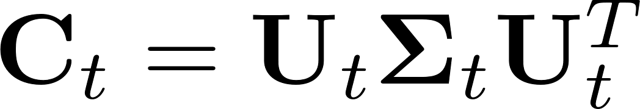

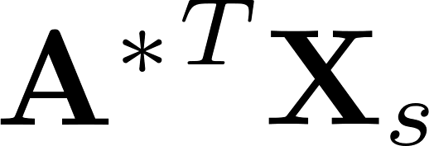
CORrelation ALignment (CORAL)
Sun, Baochen, Jiashi Feng, and Kate Saenko. "Return of frustratingly easy domain adaptation." AAAI, 2016.
and : covariance matrices of and
: covariance matrix of
align two covariance matrices
The optimal solution
After obtaining , use and

Slide 15
Relation Between DIP and CORAL
DIP: align first-order information (mean vector)
CORAL: align second-order information (covariance matrix)

Slide 16
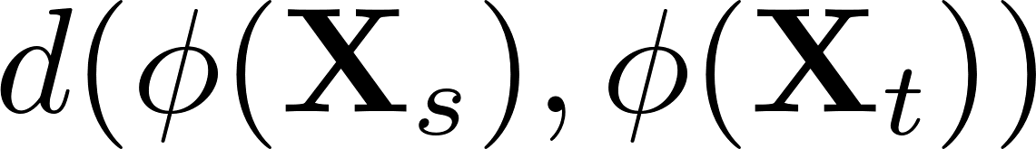
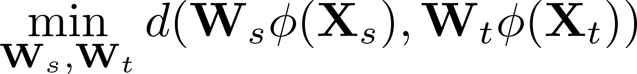


Summary
When , symmetric projection
When , asymmetric projection

Slide 17
Domain Adaptation
Traditional era
Projection to common subspace
Interpolation on the manifold
Sample selection
Domain-invariant dictionary
Low-rank reconstruction

Slide 18





Sampling Geodesic Flow (SGF)
Gopalan, Raghuraman, Ruonan Li, and Rama Chellappa. "Domain adaptation for object recognition: An unsupervised approach." ICCV, 2011.

Slide 19



Geodesic Flow Kernel (GFK)
Gong, Boqing, et al. "Geodesic flow kernel for unsupervised domain adaptation." CVPR, 2012.

Slide 20
Domain Adaptation
Traditional era
Projection to common subspace
Interpolation on the manifold
Sample selection
Domain-invariant dictionary
Low-rank reconstruction

Slide 21



Kernel Mean Matching (KMM)
Huang, Jiayuan, et al. "Correcting sample selection bias by unlabeled data." NIPS. 2007.
Step 1:
Step 2:

Slide 22


Kernel Mean Matching (KMM)
positive samples
negative samples
source
target
Assign different weights on source domain samples.

Slide 23


Kernel Mean Matching (KMM)
positive samples
negative samples
source
target
Assign different weights on source domain samples.

Slide 24

Kernel Mean Matching (KMM)
Maximum Mean Discrepancy (MMD)
positive samples
negative samples
source
target
source
target
Assigning different weights on source domain samples is equivalent to minimizing the distance between two centers.

Slide 25



Selective Transfer Machine (STM)
Chu, Wen-Sheng, Fernando De la Torre, and Jeffery F. Cohn. "Selective transfer machine for personalized facial action unit detection." CVPR, 2013.
Alternating solution:
Fix , update
Fix , update

Slide 26

Domain Adaptation SVM (DASVM)
Bruzzone, Lorenzo, and Mattia Marconcini. "Domain adaptation problems: A DASVM classification technique and a circular validation strategy." T-PAMI, 32.5 (2010): 770-787.
positive
negative
unlabeled
source domain samples
target domain samples

Slide 27
Domain Adaptation
Traditional era
Projection to common subspace
Interpolation on the manifold
Sample selection
Domain-invariant dictionary
Low-rank reconstruction

Slide 28


Shared Domain-adapted Dictionary Learning (SDDL)
Shekhar, Sumit, et al. "Generalized domain-adaptive dictionaries.“ CVPR, 2013.

Slide 29
Domain Adaptation
Traditional era
Projection to common subspace
Interpolation on the manifold
Sample selection
Domain-invariant dictionary
Low-rank reconstruction

Slide 30




Robust Domain Adaptation with Low-rank Reconstruction (RDALR)
Jhuo, I-Hong, et al. "Robust visual domain adaptation with low-rank reconstruction." CVPR, 2012.
Low rank representation
(LRR)

Slide 31

Robust Domain Adaptation with Low-rank Reconstruction (RDALR)
Low rank representation
(LRR)
RDALR

Slide 32

Low-rank Transfer Subspace Learning (LTSL)
Shao, Ming, Dmitry Kit, and Yun Fu. "Generalized transfer subspace learning through low-rank constraint." IJCV 109.1-2 (2014): 74-93.
RDALR
LTSL

Slide 33

Summary
sample selection
feature projection/encoding

Slide 34


So many methods, how to choose?
Ying Wei, Yu Zhang, and Qiang Yang. “learning to transfer." ICML, 2018

Slide 35
Domain Adaptation
Traditional era
Early deep era
GAN era

Slide 36

Traditional Machine Learning V.S. Deep Learning

Slide 37



Convolutional Neural Network
Convolutional layer:
Fully connected layer:

Slide 38
Domain Adaptation
Early deep era
Deep feature + traditional method
Deep network + traditional idea
Batch normalization based
Adversarial learning

Slide 39
Deep learning feature + Traditional method
deep learning feature + SGF
Chopra, Sumit, Suhrid Balakrishnan, and Raghuraman Gopalan. "Dlid: Deep learning for domain adaptation by interpolating between domains." ICML workshop, 2013.
deep learning feature + GFK/SA
Hoffman, Judy, et al. "One-shot adaptation of supervised deep convolutional models." arXiv preprint arXiv:1312.6204 (2013).

Slide 40
Domain Adaptation
Early deep era
Deep feature + traditional method
Deep network + traditional idea
Batch normalization based
Adversarial learning

Slide 41

Zeng, Xingyu, et al. "Deep learning of scene-specific classifier for pedestrian detection." European Conference on Computer Vision. Springer, Cham, 2014.

Slide 42

Long, Mingsheng, et al. "Learning transferable features with deep adaptation networks." arXiv preprint arXiv:1502.02791(2015).

Slide 43

Deep CORAL
Sun, Baochen, and Kate Saenko. "Deep coral: Correlation alignment for deep domain adaptation." ECCV, 2016.

Slide 44

Domain Separation Networks
Bousmalis, Konstantinos, et al. "Domain separation networks." NIPS, 2016.

Slide 45
Domain Adaptation
Early deep era
Deep feature + traditional method
Deep network + traditional idea
Batch normalization based
Adversarial learning

Slide 46












Z-score normalization
2-dim feature
-4 -2 0 2 4
-2 -1 0 1 2

Slide 47




Domain Adaptive Batch Normalization
Li, Yanghao, et al. "Revisiting batch normalization for practical domain adaptation." ICLR workshop, 2017
BN
BN
BN
BN
BN
BN

Slide 48






Domain Adaptive Batch Normalization
Cariucci, Fabio Maria, et al. "Autodial: Automatic domain alignment layers." ICCV, 2017.
DA layer
softmax loss
entropy loss

Slide 49
Domain Adaptation
Early deep era
Deep feature + traditional method
Deep network + traditional idea
Batch normalization based
Adversarial learning

Slide 50
Not only classify categories, but also classify domains.
category classifier
domain classifier

Slide 51

Tzeng, Eric, et al. "Simultaneous deep transfer across domains and tasks." ICCV, 2015.

Slide 52

Ganin, Yaroslav, and Victor Lempitsky. "Unsupervised domain adaptation by backpropagation." arXiv preprint arXiv:1409.7495 (2014).

Slide 53
Domain Adaptation
Traditional era
Early Deep era
GAN era

Slide 54
Previous adversarial learning: feature-level
Generative Adversarial Network: image-level

Slide 55




Generative Adversarial Network (GAN)
discriminator
real (1) or fake (0)?
generator
real (1) or fake (0)?

Slide 56



Conditional GAN
discriminator
real (1) or fake (0)?
generator
real (1) or fake (0)?

Slide 57
Domain Adaptation
GAN era
Paired GAN
Unpaired GAN

Slide 58

pix2pix
Isola, Phillip, et al. "Image-to-image translation with conditional adversarial networks." CVPR. 2017

Slide 59

pix2pix

Slide 60
Domain Adaptation
GAN era
Paired GAN
Unpaired GAN

Slide 61


Slide 62



Cycle GAN
Zhu, Jun-Yan, et al. "Unpaired image-to-image translation using cycle-consistent adversarial networks." ICCV, 2017.
cycle

Slide 63


Cycle GAN

Slide 64



Emerging Research Directions
Open-set domain adaptation/partial transfer learning
Panareda Busto, Pau, and Juergen Gall. "Open set domain adaptation." ICCV, 2017.

Slide 65


Emerging Research Directions
Distant domain adaptation
Tan, Ben, et al. "Transitive transfer learning." SIGKDD, 2015.
Tan, Ben, et al. "Distant domain transfer learning." AAAI, 2017.

Slide 66
Thanks!

